Slide 1
Customer Care Center Overview
Russell Williams
Director, Customer Care
October 16, 2024

Slide 2

Mission Statement
To respond to customer inquiries and requests courteously and professionally, while providing a customer experience that offers consistent and accurate information in a timely manner.

Slide 3
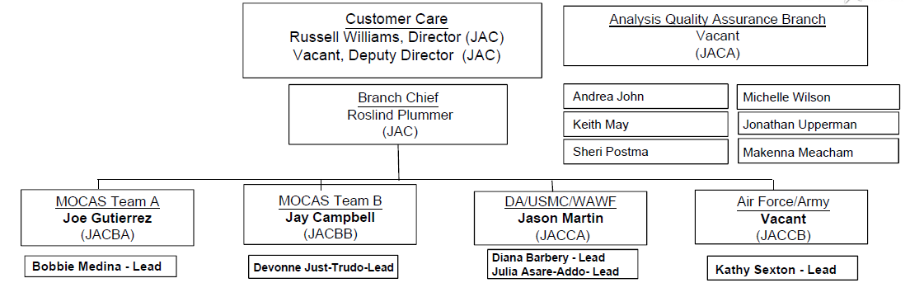
Organization Structure

Slide 4
Customer Care Phone Tree
Columbus Care Center
800-756-4571
Daily 7:30AM - 4:30PM EST
MOCAS
OPTION 1
Codes
HQ0337
HQ0338
HQ0339
Defense
Agencies
OPTION 2
Codes
HQ0104
HQ0131
HQ0252
HQ0492
HQ0600
HQ0622
HQ0623
HQ0645
HQ0646
HQ0690
HQ0748
HQ0750
HQ0751
HQ0790
HQ0806
HQ0809
HQ0810
HQ0831
SL4701
ARMY
OPTION 3
Codes
HQ0303
HQ0304
Air Force
OPTION 4
Codes
F03000
F67100
F78900
F87700
F89900
Marine Corps
OPTION 5
Codes
M67443
WAWF Technical Assistance
OPTION 6
Outreach
OPTION 7

Slide 5


Incoming Workload
FY24 Incoming Calls
Care Center: 74,977
FY24 AskDFAS
Care Center: 44627

Slide 6
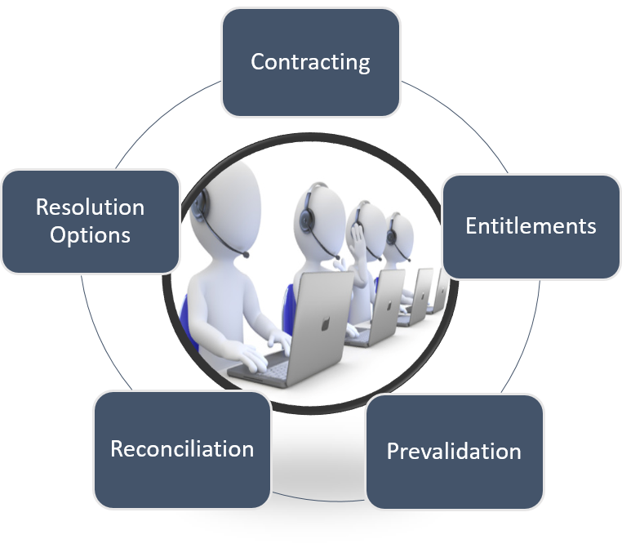
CSR Responsibilities
First POC: Customer Service Representative (CSR)
  Receive & provide status for customer inquiries
  (Calls, Email, Fax)
  Research & resolve payment related issues
  Provide myInvoice & WAWF/iRAPT assistance
  Participate in customer visits/conferences

Slide 7
Customer Care Focus Groups
Small Business Initiative
  Contractor Open Houses & WAWF Workshop
  Small Business Week
  Small Business Communication Initiatives
Aerospace Industry Association Collaboration
  Monthly AIA Calls
  Inquiry Reduction Efforts
Targeted Customer Outreach
  Data Analysis to identify repeat callers and problem invoices
  Customer collaboration of problem contracts

Slide 8
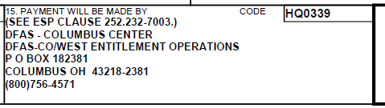
Helpful Tips
Know your DFAS payment office
  Found on the face page of your contract, on the right hand side, in the block entitled “Payment will be made by”
Check myInvoice: https://wawf.eb.mil
Contact your Customer Care team
  800-756-4571, choose the option for the appropriate payment office (see page 5)
  Provide payment inquiry information, including the contract number

